Slide 1
Software Product Line Architectures for Cloud-based Applications
CS587 – Software Project Management
Team 23
Seungho Han (A20360115)
Saurabh Tiwari (A20356308)
Sangwon Moon (A20259651)
Feiyu Chen (A20349269)
Subakar Sundarababu Elango (A20345012)
28 April 2017

Slide 2
Agenda
Motivation
Background
Software Product Line
SPL & Software Development
SPL & Cloud
Comparison
Challenges
Summary
Credits
Questions
28 April 2017

Slide 3
Motivation
Resource Shortage
Cost Reduction
Reduce Complexity
Credibility & Trust
Scalability
Time to Market
Quality
28 April 2017

Slide 4
Background
Cloud
SaaS
PaaS
IaaS
Architecture
Variability
SPL
Software
Development
28 April 2017

Slide 5
Background
Cloud:
The practice of using a network of remote servers hosted on the Internet to store, manage, and process data, rather than a local server or a personal computer.
Classification:
Cloud computing is usually described in one of two ways. Either based on the cloud location, or on the service that the cloud is offering.
Location
Public
Private
Hybrid (Public + Private)
Community Cloud
Service
IaaS (Infrastructure-as-a-Service)
PaaS (Platform-as-a-Service)
SaaS (Software-as-a-Service)
28 April 2017

Slide 6
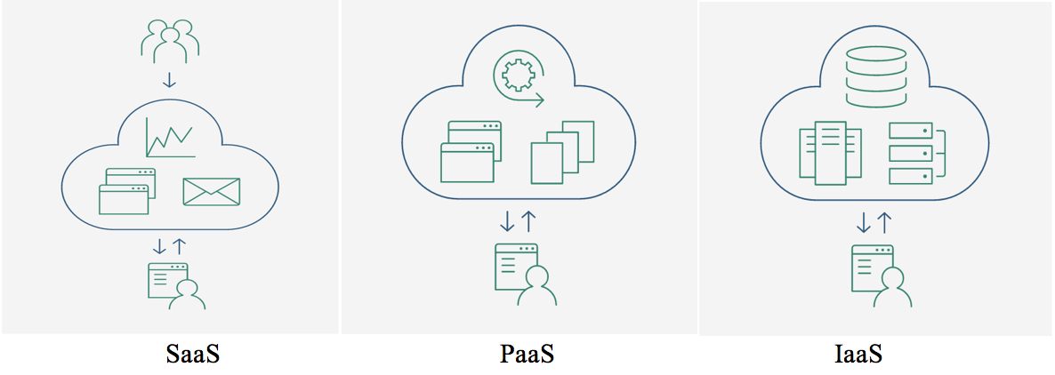
Background
Classification:
28 April 2017

Slide 7
Software Product Line
Definition
Software product line is a set of software intensive systems sharing a common, managed set of features that satisfies specific customer segments or products developed from common set of core assets in a defined way.
Software Product Line (SPL) uses multiple intellectual assets in multiple projects or product.
Reuse
Components
Ideas
Test
Patent
Family of products
Share most of the essential functions
28 April 2017

Slide 8
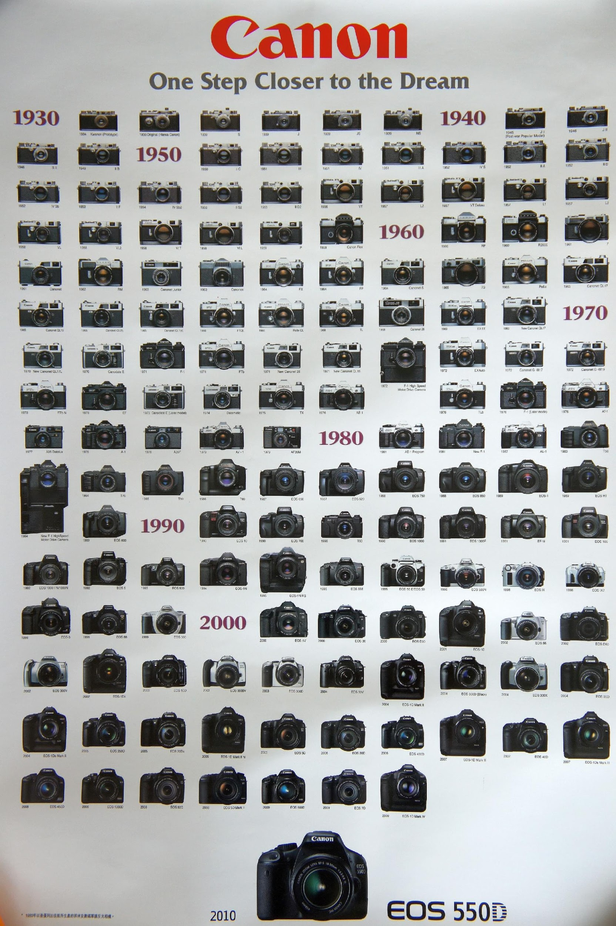
Product Line
Source: http://ricehigh.blogspot.com/2011/05/major-canon-cameras-1930-to-2010.html
28 April 2017

Slide 9
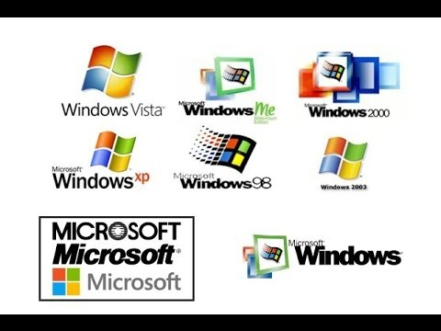
Software Product Line
Source: https://www.wikipedia.org/
28 April 2017

Slide 10
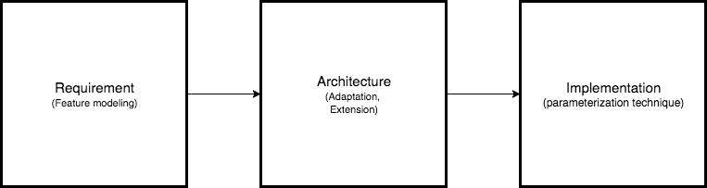
SPL & Software Development
Requirement
Development
Implementation
28 April 2017

Slide 11
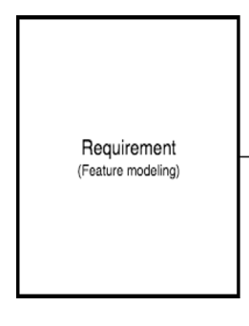
SPL & Software Development
Requirement
Blueprint of shared and volatile domain requirements.
Feature modeling.
FORM (Feature-Oriented Reuse Method).
Capture SPL shared parts and fluctuating parts.
Mandatory, which are common to all products.
Optional, which may or may not be selected for a particular product.
Alternative, which results in one or more features being selected from a set.
28 April 2017

Slide 12
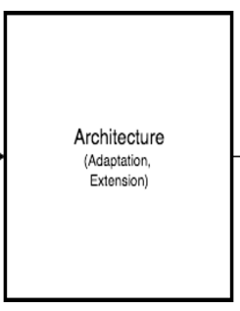
SPL & Software Development
Modeling
Create structural and behavioral pattern with FORM approach to design an application architecture.
Subsystem model defines the overall structure by grouping functionalities into subsystems.
Process model represents the dynamic behavior of each sub system.
In this architecture phase, components have been used to model the SPL to achieve modularization and reusability.
28 April 2017

Slide 13
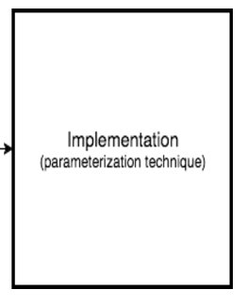
SPL & Software Development
Implementation
Implementation using SPL technique is to implement a system based on SPL architecture.
Determined variability in the architecture phase is implemented in this implementation phase.
Multiple variable features are implemented from a single architecture feature.
Different binding times (compile time, loading time, and run-time) for each variability are defined respectively.
28 April 2017

Slide 14
SPL & Cloud
The software product line requires a commonality and variability analysis so that the host organization can characterise successful product line organizations.
Different Product lines use different production methods.
Cloud based systems which are evolving to respond to changing client requirements.
As SPL development techniques rely on feature models to describe the commonality and variability of family member applications, such techniques can be used to model variability in SaaS.
Variability framework for building and customizing SaaS multi-tenant application.
28 April 2017

Slide 15
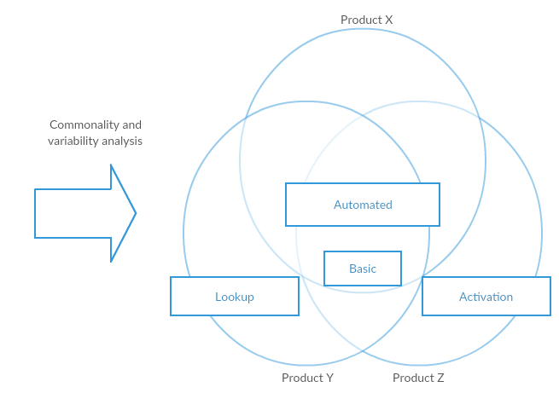
Variability Study
Application Variability
Business Process Variability
Platform variability
Provisioning Variability
Deployment variability
Provider Variability
28 April 2017

Slide 16
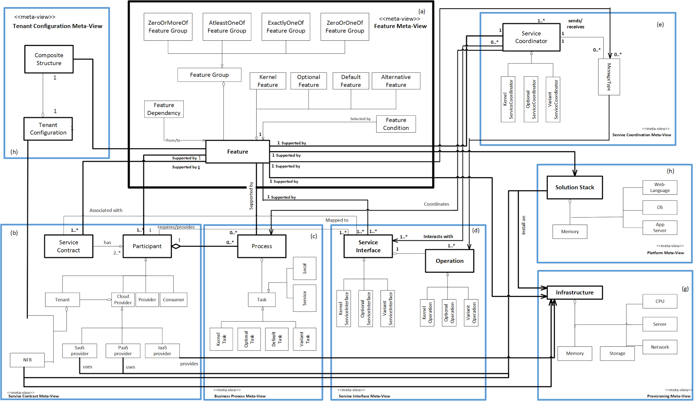
Multiple view cloud variability Meta-Model
28 April 2017

Slide 17
SPL- Multitenant SaaS Application
SaaS kernel development
Platform Independent Models to Platform Specific Models
Kernel would be a part of all the future SaaS
New Tenants Onboarding
one application requires more CPU cycles and the other requires more network bandwidth
Installed on the same kernel modules
Existing Tenants Customization
Already boarded application is customized
28 April 2017

Slide 18
Comparison
Towards Software Product Lines Based Cloud Architectures
A multiple-view modeling approach which deals with service-oriented cloud systems variability.
Incorporating for SPL concepts and variability analysis techniques to model variability of cloud systems.
Architecting Cloud Tools using Software Product Line Techniques: an Exploratory Study
Applying SPL techniques to a software development process of practical cloud tools that control their own variabilities.
Using feature modeling to capture the variabilities and synchronize it into the cloud architecture.
Applying Software Product Lines to create Customizable Software-as-a-Service Applications
Making use of SPL ideal to make applications can be mass produced(Modular production)
Creating applications based on generic model designed by SPL techniques
Apply SPL tech to solve SaaS’s issue(too complex to assemble), then make it customizable

Slide 19
Challenges
Adapting to cloud
Configuration challenges
Dynamic behavior
Customization
Varied customer segments

Slide 20
Summary
Cloud basics
Software Product Line background
Cloud Service and Software Product Line
Phases in Cloud and SPL
Challenges ahead

Slide 21
Credits
Klaus Schmid, Andreas Rummler, “Cloud-based Software Product Lines” SPLC ‘12 Proceedings of the 16th International Software Product Line Conference - Volume 2, 164-170, 2012.
Andre Almeida, Everton Cavalcante, Thais Batista, Frederico Lopes, Flavia C. Delicato, Paulo F. Pires, Gustavo Alves, Nelio Cacho, “Towards an SPL-Based Monitoring Middleware Strategy for Cloud Computing Applications,” MGC ‘12 Proceedings of the 10th International Workshop on Middleware for Grids, Clouds and e-Science Artical No. 9, 2012.
Leonardo P. Tizzei, Leonardo G. Azevedo, Maximilien de Bayser, and Renato F. G. Cerqueira, “Architecting Cloud Tools using Software Product Line Techniques: an Exploratory Study,” SAC ‘15 Proceedings of the 30th Annual ACM Symposium on Applied Computing pages 1441-1448, 2015.
Stefan T. Ruehi, Urs Andelfinger, “Applying Software product Lines to create Customizable Software-as-a-Service Applications,” SPLC’ 11 Proceeding of the 15th International Software Product Line Conference, Volume 2 Article No. 16, 2011.
Mohammad Abu Matar, Rabeb Mizoum, and Salwa Alzahmi, “Towards Software Product Lines Based Cloud Architectures,” IEEE International Conference on Cloud Engineering, 2014.

Slide 22
Questions?

